Slide 1




Robustness of Complex Networks: Criteria, Computation &. Optimization
Felix, Yang Lou
Associate Professor, H&J Youth Chair Professor
Department of Computer Science National Yang Ming Chiao Tung University
14 February 2025
Notes:
My third CCCN presentation
First time = Naming Game;
Second time = CNN for Robustness Evaluation

Slide 2



About Me
2013 – 2017, Ph.D., EE. City University of Hong Kong (CityU)
2017 – 2021, Postdoc and Research Fellow, EE and CCCN, CityU
2021 – 2022, Research Assistant Professor, CDS, Lingnan University
2022 – 2023, Researcher, IST, Osaka University, Japan
2023 – 2025, Assistant Professor, National Yang Ming Chiao Tung University (NYCU)
2025/02/01 – Associate Professor (tenured), NYCU
Notes:
[Ph.D.] Optimization (Evolutionary Computation)
[Postdoc] Complex networks
[Osaka] Optimization for digital-twin systems
[NYCU] communication systems involves LEO (Low Earth Orbit) satellite and UAV (Unmanned Aerial Vehicle) uhn-MAND AIR-ee-uhl VEE-uh-kul
Get promoted and tenured in 1.5 year

Slide 3
About Me (cont'd)
PI: Network Science and Graph Learning Lab
Member: Communication Service/Software Lab
H&J Youth Chair Professor
Fellow of the Higher Education Academy (FHEA)
Senior Member of IEEE

Slide 4
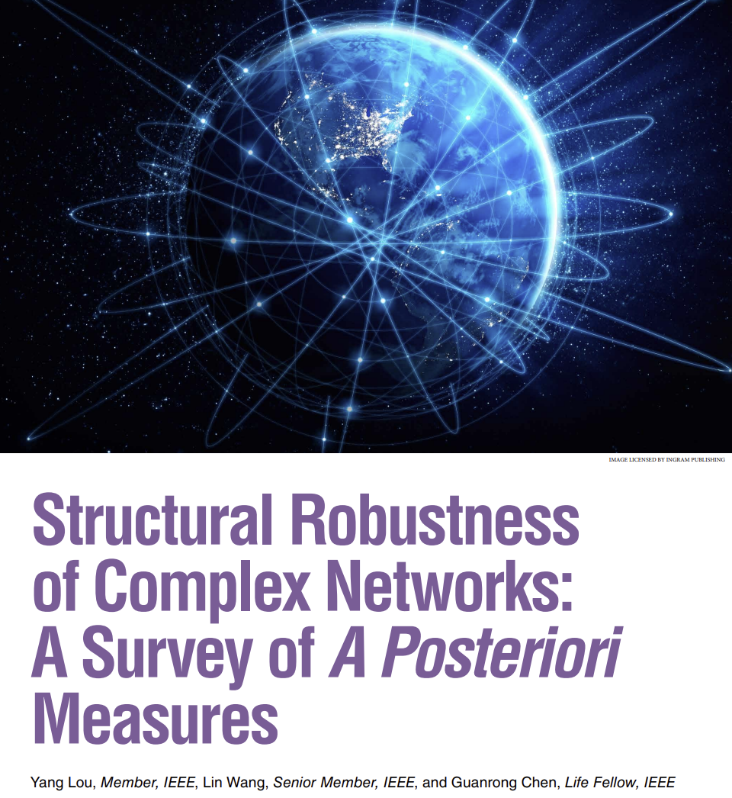
Contents
Preliminaries
Evaluation and Prediction
Optimization
Summary
IEEE Circuits and Systems Magazine, 23(1): 12–35 (2023)
Notes:
This talk basically based on this Survey paper
Summarizes our work from 2018 -- now
3 main parts in this talk:
Preliminaries
Evaluation and Prediction
Optimization

Slide 5
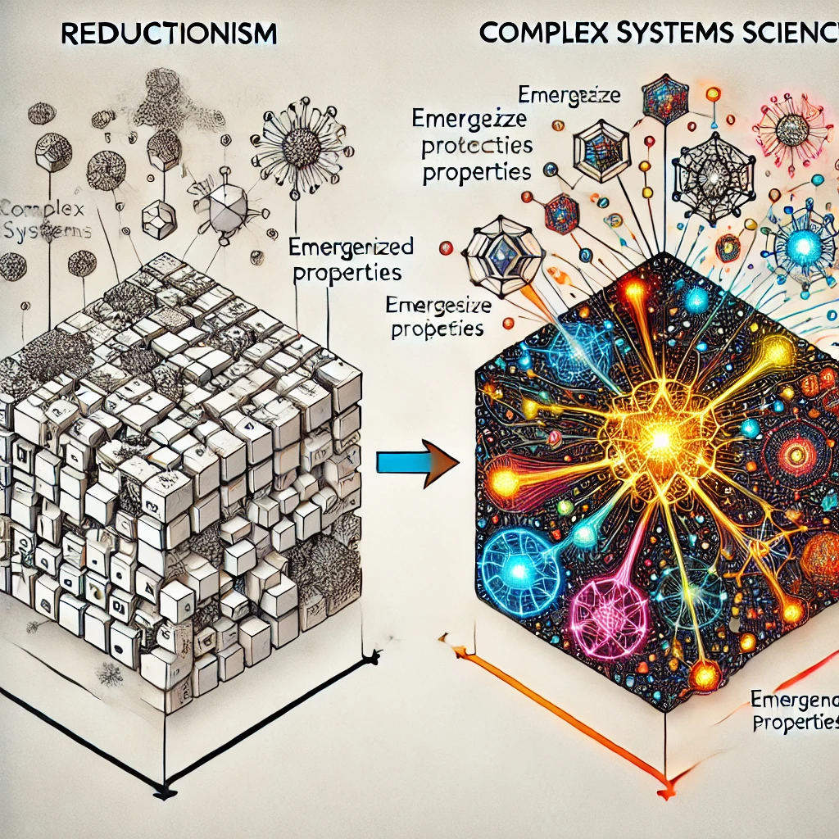

Preliminaries
Most Science ⇨ Divide and Conquer
Complex System ⇨ Holistic Integration
Complex Networks
Generated by ChatGPT 4o
Notes:
My perspective of the research problem
Traditional scientific approaches often focus on reductionism, where a problem is divided into smaller, more manageable parts to study them in isolation:
From the body to cells, to molecules /ˋmɔlikju:l/, and down to atoms.
However, complex system focuses on HOW THESE COMPONENTS CAN WORK TOGETHER? As if in a reverse way.
Complex network is an even abstracted model of complex system, focusing on the connections and interaction of the elements of the system.

Slide 6




Robustness
Network Robustness, the ability to withstand failures and perturbations, is a critical attribute of many complex systems.
Ecosystems
e.g., extinction of species
Robustness
Biological Systems
e.g., diseases and mutations
Economics
e.g., financial risks
Engineering
e.g., resilience of infrastructure networks
Notes:
We care the controllability, connectivity, and other functionalities… of complex networks, also care how theses functionalities degenerated during an attack process.
“Robustness” has different meanings
Ecosystems /ˋekəusistəms/

Slide 7
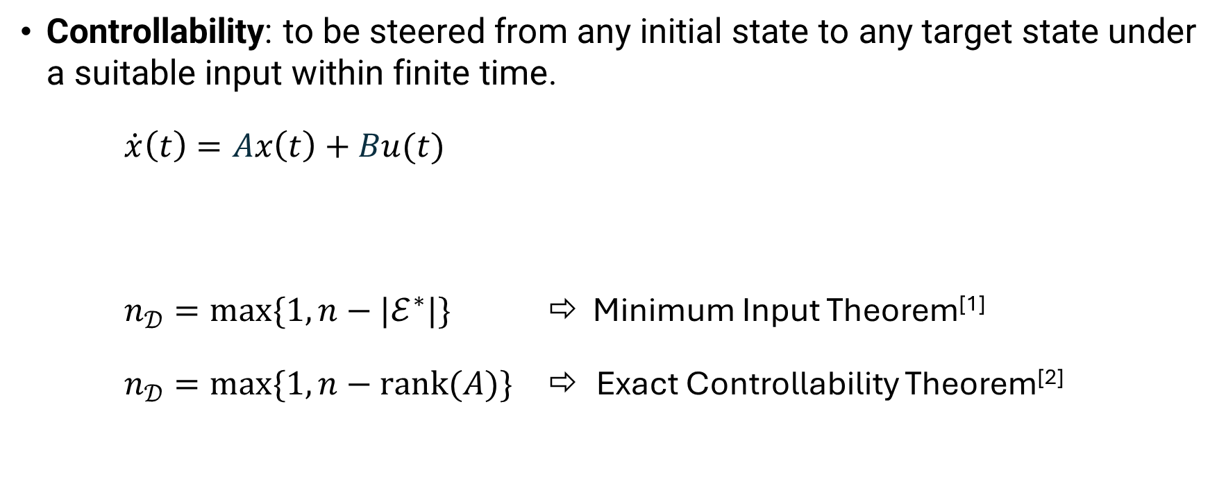
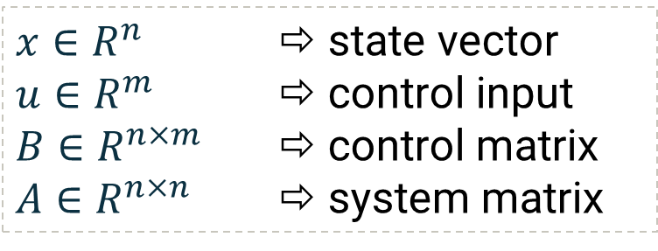
Controllability
Controllability: to be steered from any initial state to any target state under a suitable input within finite time.
$\dot{x}\left(t\right)=Ax\left(t\right)+Bu(t)$
$n_{𝒟}=max\{1, n−|ℰ^{∗}|\}$ ⇨ Minimum Input Theorem^{[1]}
$n_{𝒟}=max\{1, n−rank(A)\}$ ⇨ Exact Controllability Theorem^{[2]}
$x∈R^{n}$ ⇨ state vector
$u∈R^{m}$ ⇨ control input
$B∈R^{n×m}$ ⇨ control matrix
$A∈R^{n×n}$ ⇨ system matrix
Y. Liu, J. Slotine & A. Barabási. Controllability of Complex Networks. Nature. 473: 167–173 (2011)
Z. Yuan, C. Zhao, Z. Di, W. Wang & Y. Lai. Exact Controllability of Complex Networks. Nature Communications. 4: 2447 (2013)
Notes:
We pay some specific attention to the controllability

Slide 8
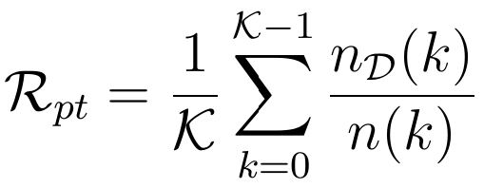
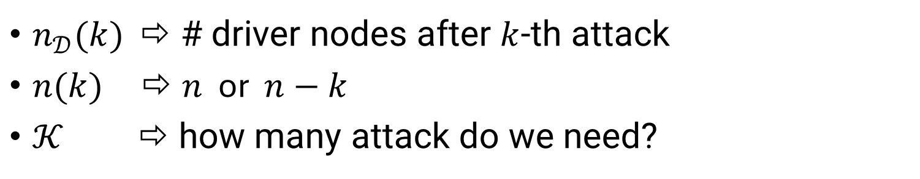
Percolation Theory-based Metrics
$n_{𝒟}(k)$ ⇨ # driver nodes after $k$-th attack
$n(k)$ ⇨ $n$ or $n−k$
$𝒦$ ⇨ how many attack do we need?
Notes:
Percolation Theory-like robustness metrics were firstly used for measuring connectivity robustness
Portion of needed driver nodes, which can be freely set anywhere
This metric focuses on calculating the theoretical minimum number of driver nodes

Slide 9
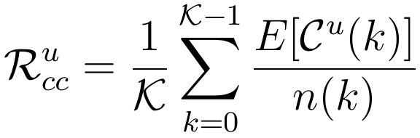
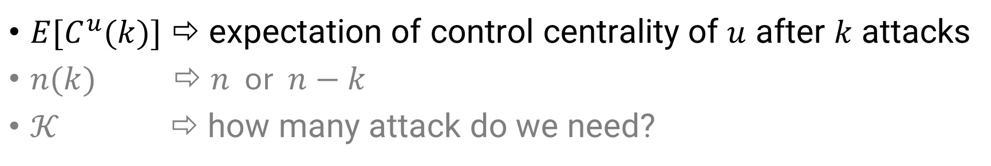
Control Centrality-based Metrics
$E[C^{u}(k)]$ ⇨ expectation of control centrality of $u$ after $k$ attacks
$n(k)$ ⇨ $n$ or $n−k$
$𝒦$ ⇨ how many attack do we need?
Notes:
Control centrality-based focus on the control power of single node as the driver
The controller is fixed on the determined node, see how the range controlled by this node changes during attacks
Results can be used to choose the most suitable driver nodes

Slide 10
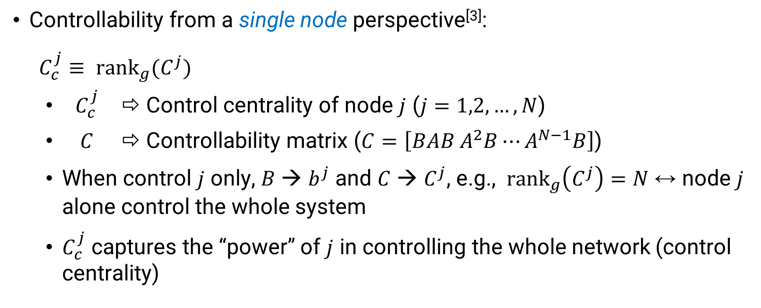
Control Centrality-based Metrics (cont'd)
Controllability from a single node perspective^{[3]}:
$C_{c}^{j}≡ {rank}_{g}(C^{j})$
$C_{c}^{j}$ ⇨ Control centrality of node $j$ ($j=1,2,…, N$)
$C$ ⇨ Controllability matrix ($C=\left[BAB A^{2}B⋯A^{N−1}B\right]$)
When control $j$ only, $B$ → $b^{j}$ and $C$ → $C^{j}$, e.g., ${rank}_{g}\left(C^{j}\right)=N$ ↔ node $j$ alone control the whole system
$C_{c}^{j}$ captures the “power” of $j$ in controlling the whole network (control centrality)
Y. Liu, J. Slotine, & A. Barabási. Control Centrality and Hierarchical Structure in Complex Networks. PLoS One, 7: e44459 (2012)
Notes:
$B$ = control matrix (with respect to the control input)
$C$ = controllability matrix
${rank}_{g}(C^{j})$ = generic dimension of the controllable subspace associated with node $j$

Slide 11
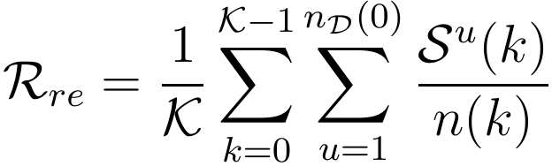
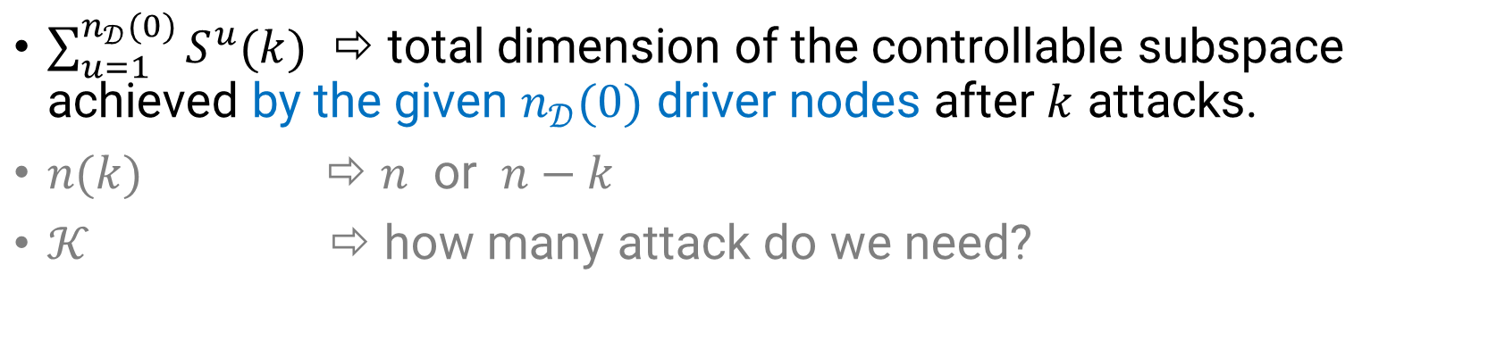
Reachability-based Metrics
$\sum_{u=1}^{n_{𝒟}(0)}{S^{u}(k)}$ ⇨ total dimension of the controllable subspace achieved by the given $n_{𝒟}(0)$ driver nodes after $k$ attacks.
$n(k)$ ⇨ $n$ or $n−k$
$𝒦$ ⇨ how many attack do we need?
Notes:
The number of driver nodes is fixed, but can be installed anywhere
Both the number of position of drivers are fixed

Slide 12
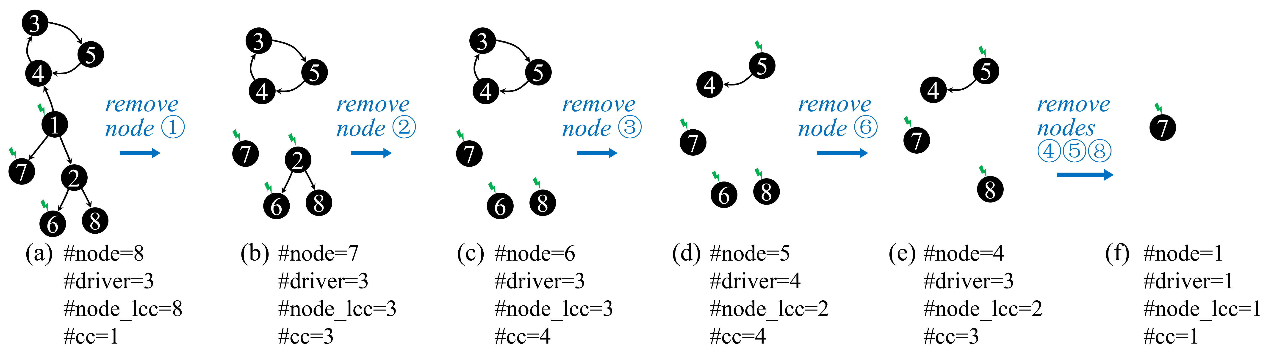
Robustness Metrics
Controllability robustness is positively related to connectivity robustness; however, their behaviors differ significantly.
Notes:
We consider the robustness of multiple functionalities, including controllability, connectivity, and other functionalities…
Somehow positively related, but not so rclear

Slide 13
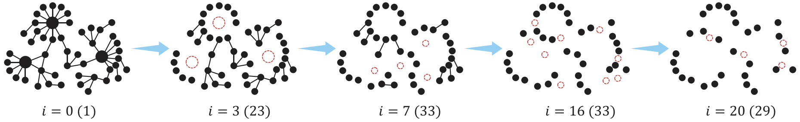
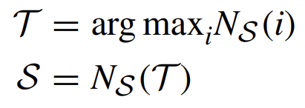
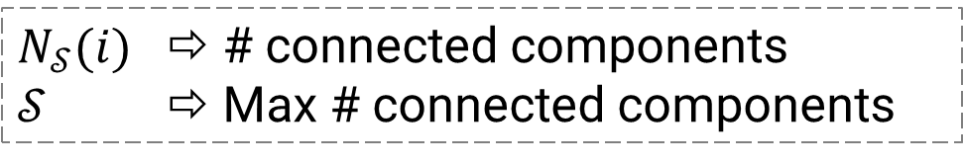
Stopping Criteria
$N_{𝒮}(i)$ ⇨ # connected components
$𝒮$ ⇨ Max # connected components
C. Wu, Y. Lou, J. Li, L. Wang, S. Xie, & G. Chen. A Multitask Network Robustness Analysis System Based on the Graph Isomorphism Network,” IEEE Transactions on Cybernetics, 54(11): 6630–6642 (2024)
Notes:
Example of degree-based attack,
$i$ = # of attacks
# in parentheses = # of connected components
at the 16th attack, there is no edge at all, # of connected components = # of nodes (we must stop calculating the robustness)
In this example, $𝒯=16$, $𝒮=33$

Slide 14

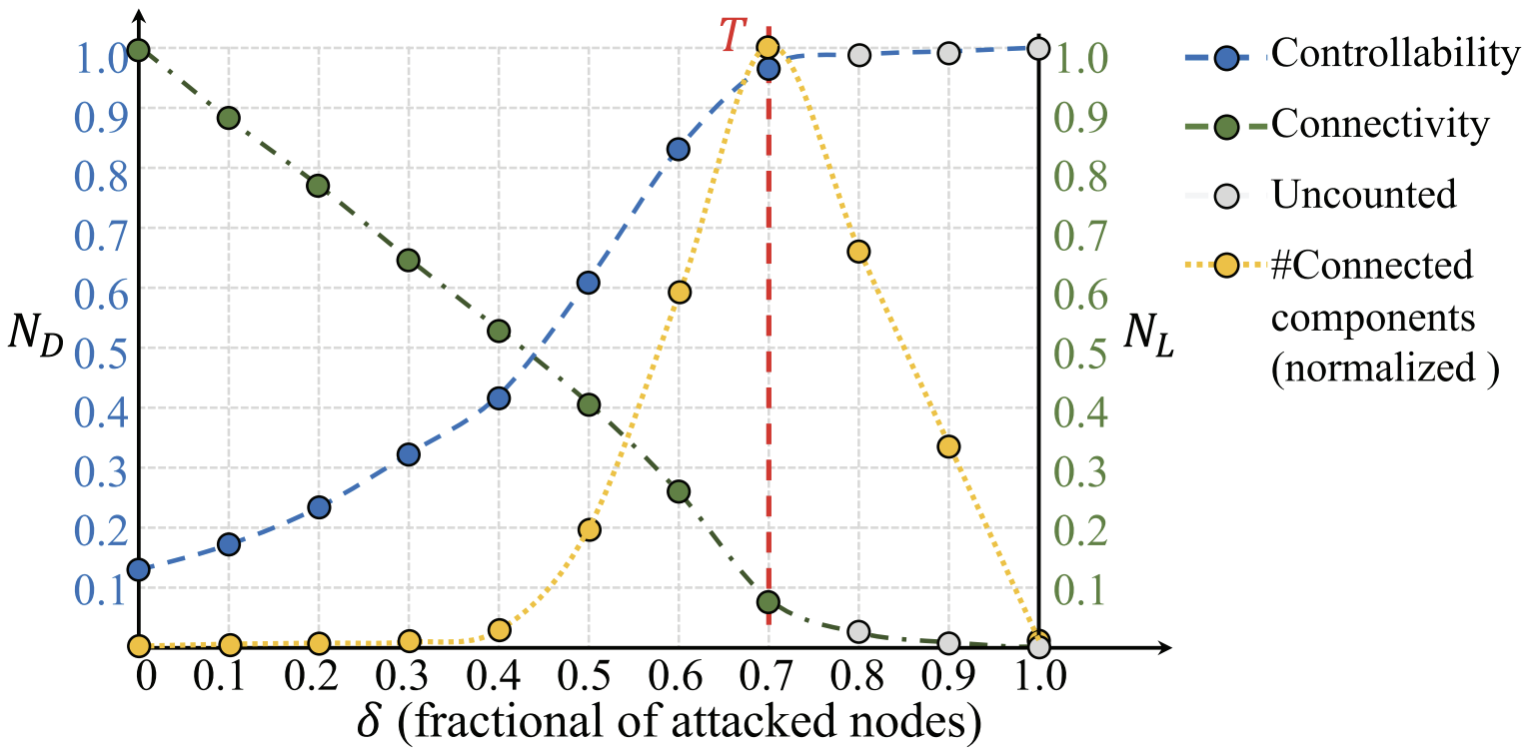
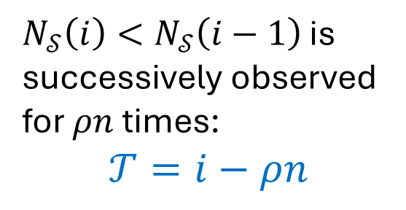
Stopping Criteria (cont'd)
$N_{𝒮}\left(i\right)<N_{𝒮}\left(i−1\right)$ is successively observed
for $ρn$ times:
$$𝒯=i−ρn$$
Notes:
# Connected Components ⬆ in the earlier stage, and ⬇ in the later stage
Yellow dots
Red vertical line = Stopping criterion
Blue and green dots

Slide 15
Attack Strategies
Attack Strategies
Random
Structural Feature-based
Damage-based
Computational Intelligence-based
Data-Driven
Notes:
Random attacks attack random nodes
Structural Feature-based : degree, betweenness, and so on
Damage-based: focuses on the maximum gain by single steps, mostly based on trial-and-error manner
Computational Intelligence-based: similar to “Damage-based”, but in a Global manner, optimizing the sequence to maximize the damage
Data-Driven: related to machine learning, the most idealistic approach is that can learn from small and synthetic models, and can be generalized to real-world data

Slide 16
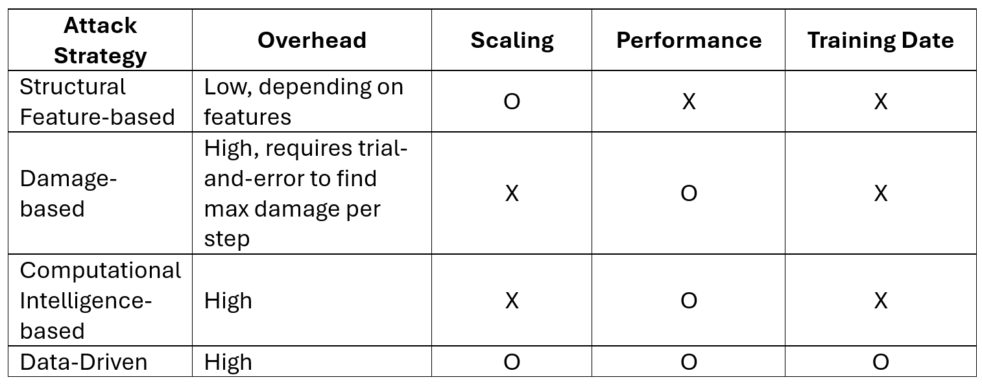
Attack Strategies (cont'd)

Slide 17
Contents
Preliminaries
Evaluation and Prediction
Optimization
Summary

Slide 18
A Priori vs A Posteriori
A Priori Metrics:
Robustness from intrinsic properties (e.g., topology, eigen-spectrum)
Low computational cost
Grounded in theory or validated observations
A Posteriori Metrics:
Robustness via attack simulation
High computational cost
Assumption-free & adaptable
Y. Lou, L. Wang, & G. Chen. Structural Robustness of Complex Networks: A Survey of A Posteriori Measures, IEEE Circuits and Systems Magazine, 23(1): 12–35 (2023)
Notes:
A Priori Metrics
Rely on theoretical implications, assumptions, or well-supported practical observations
Low computational cost
Example: associativity – connectivity robustness
A Posteriori Metrics
all previously introduced metrics

Slide 19


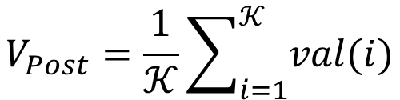
A Priori vs A Posteriori
Network Diameter
$$V_{Post}=\frac{1}{𝒦}\sum_{i=1}^{𝒦}{val(i)}$$
Degree Distribution
Algebraic Connectivity
Spectral Gap
Modularity
Clustering Coefficient
Assortativity
Controllability Robustness
Redundancy
Average Path Length
Connectivity Robustness
Edge Density
Core-Periphery Structure
Communication Robustness
Efficiency
Betweenness Centrality
…
…
Y. Lou, L. Wang, & G. Chen. Structural Robustness of Complex Networks: A Survey of A Posteriori Measures, IEEE Circuits and Systems Magazine, 23(1): 12–35 (2023)
Notes:
General Form of A Posteriori Metrics
A Priori Metrics? Features
What if we use a posteriori metrics, but the computation cost is as little as a priori?

Slide 20
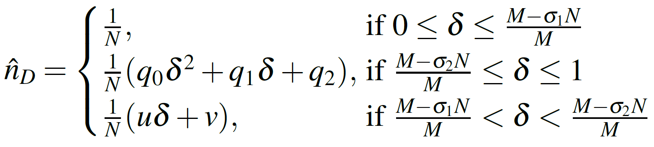
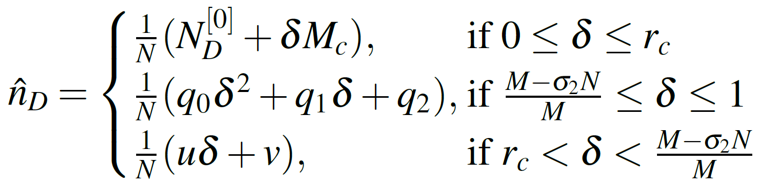
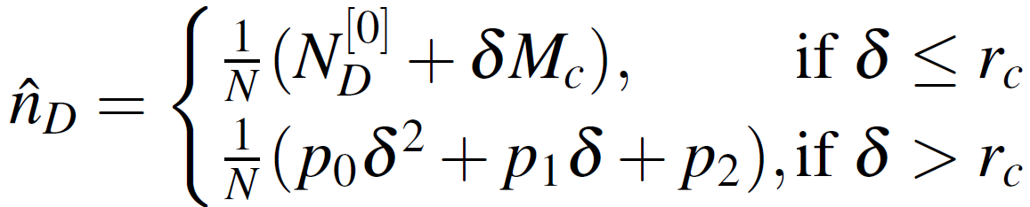
Analytical vs Computational
Analytical:
Pros: Extremely low cost, highly precise
Cons: Requires attack strategy to be modelled
Dense:
Median:
Sparse:
Y. Lou, L. Wang, S. Xie, & G. Chen. Approximating the Controllability Robustness of Directed Random-Graph Networks Against Random Edge-Removal Attacks, International Journal of Control Automation and Systems, 21(2): 376-388 (2023)
Notes:
Target: To evaluate robustness, and to detour the time-consuming simulation process
Rely on theoretical implications, assumptions, or well-supported practical observations
Low computational cost
We observed: generation process of ER model = random attack process

Slide 21
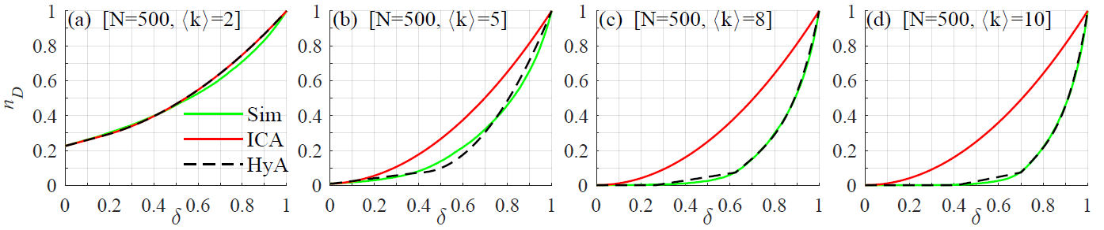
Analytical vs Computational (cont'd)
HyA outperforms ICA (Initial Controllability-based Approximation)^{[7]}
HyA approximated curve is close to the simulation result (Sim)
Robustness approximation is significantly faster than attack simulation
P. Sun, R. E. Kooij, & P. Van Mieghem. Reachability-Based Robustness of Controllability in Sparse Communication Networks. IEEE Transactions on Network and Service Management, 18(3): 2764–2775 (2021)

Slide 22
Analytical vs Computational (cont'd)
Machine Learning-based Evaluation:
Limited theoretical studies on network robustness
e.g., controllability robustness
Spectral measures and analytical approximations are precise only when attack processes and performance metrics are well-modeled
e.g., random or max-degree attacks
A posteriori simulations are time-consuming
Notes:
Computational approaches are data-driven approaches, which leverage the advancement of Machine Learning and Deep Learning

Slide 23




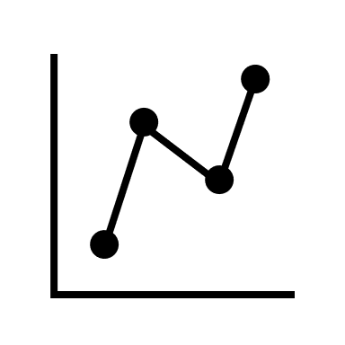


Analytical vs Computational (cont'd)
Learn from synthetic networks; apply to real-world systems.
Deep Neural Network Model
Synthetic & Real-world Data
Predict & Analyze Robustness Performance for Real-world Networks
Enhance Human Understanding of Network Robustness
Notes:
Ultimate target: Learn from synthetic networks, which could be small or large-scaled, and we can generate many;
And apply to real-world systems, which are in general large-scaled, and sometimes, lack of complete knowledge of them

Slide 24

Straightforward Predictor:
Adjacency converted image as input
Simple, precise, fast, but unstable
TCBY 22
2D-CNN (7 FMs)
TNNLS 22
NN23
Straightforward multi-CNN Predictor:
Use prior knowledge
Improved version of single CNN
Knowledge-based Classification
2D-CNN (7 FMs)
TCYB 23
TNNLS 24
LFR: SAN
GE + CNN Predictor:
HD → LD
Balance between GE and CNN, but outperforms both
Selection
1D/2D-CNN
Complex Network Data
Assembly
Normalization
Performance Prediction
TCASI 23
Pyramid Pooling-based CNN Predictor:
As fast as straightforward CNN
As good as LFR-based CNN
SPP-CNN
TCYB 24
GIN + Multi-task learning
Graph Isomorphism Network:
Multitask evaluation
Fast, precise, and generalizable

Slide 25

Attack Simulation, CNN, and GNN
Attack Simulation
CNN
Network Data
Evaluation
1
1
2
1
1
2
2
1
2
GNN
2
3
3
3
3
4
4
3
4
4
5
5
4
5
5
5
Notes:
3 different way for the same graph-data processing

Slide 26
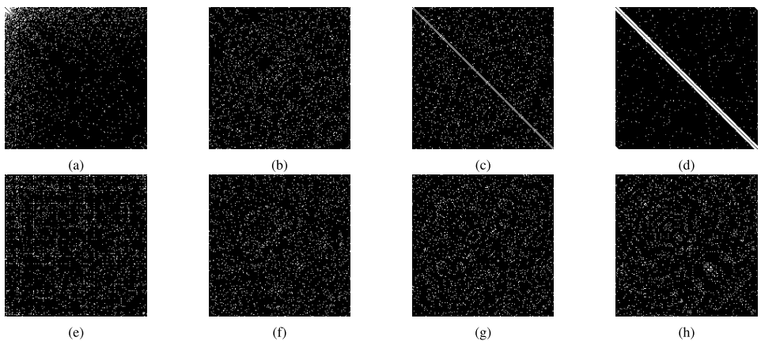
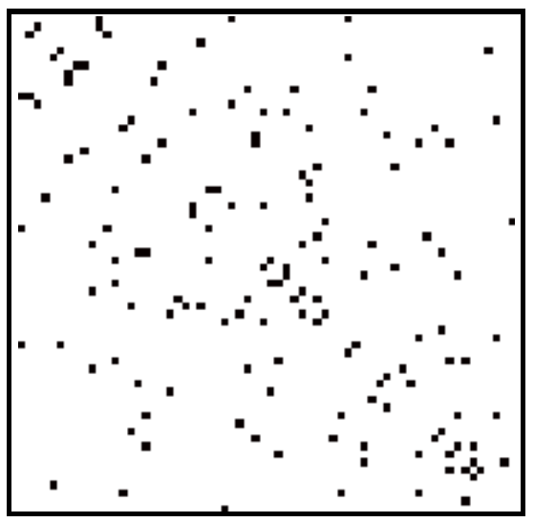
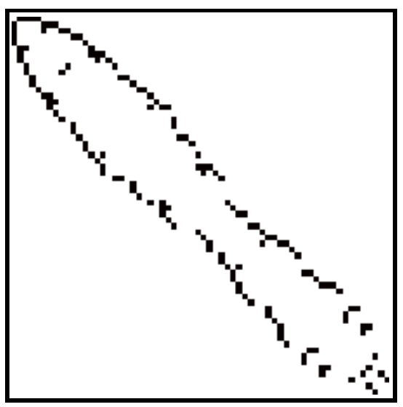
Graph Representation
SF
ER
QSN
SW
Road Network
Y. Lou, Y. He, L. Wang, K. F. Tsang, & Chen, G. Knowledge-based Prediction of Network Controllability Robustness. IEEE Transactions on Neural Networks and Learning Systems, 33(10): 5739–5750, (2021)
K. Hegde, M. Magdon-Ismail, R. Ramanathan, & B. Thapa. Network Signatures from Image Representation of Adjacency Matrices: Deep/transfer Learning for Subgraph Classification. arXiv preprint arXiv:1804.06275, (2018)
Notes:
[2017-2018] Deep neural networks, CNN
A very straightforward representation of graph
non-Euclidean Data vs Euclidean Data

Slide 27



Using CNN for Robustness Evaluation
Graph Representation Learning
CNN
Output: Robustness Performance
Y. Lou, R. Wu, J. Li, L. Wang, X. Li, & G. Chen. A Learning Convolutional Neural Network Approach for Network Robustness Prediction. IEEE Transactions on Cybernetics, 53(7): 4531–4544 (2023)
Notes:
General CNN
-- Advanced CNN models, such as SPP (spatial pyramid pooling …) and others
-- Advanced learning representation techniques

Slide 28
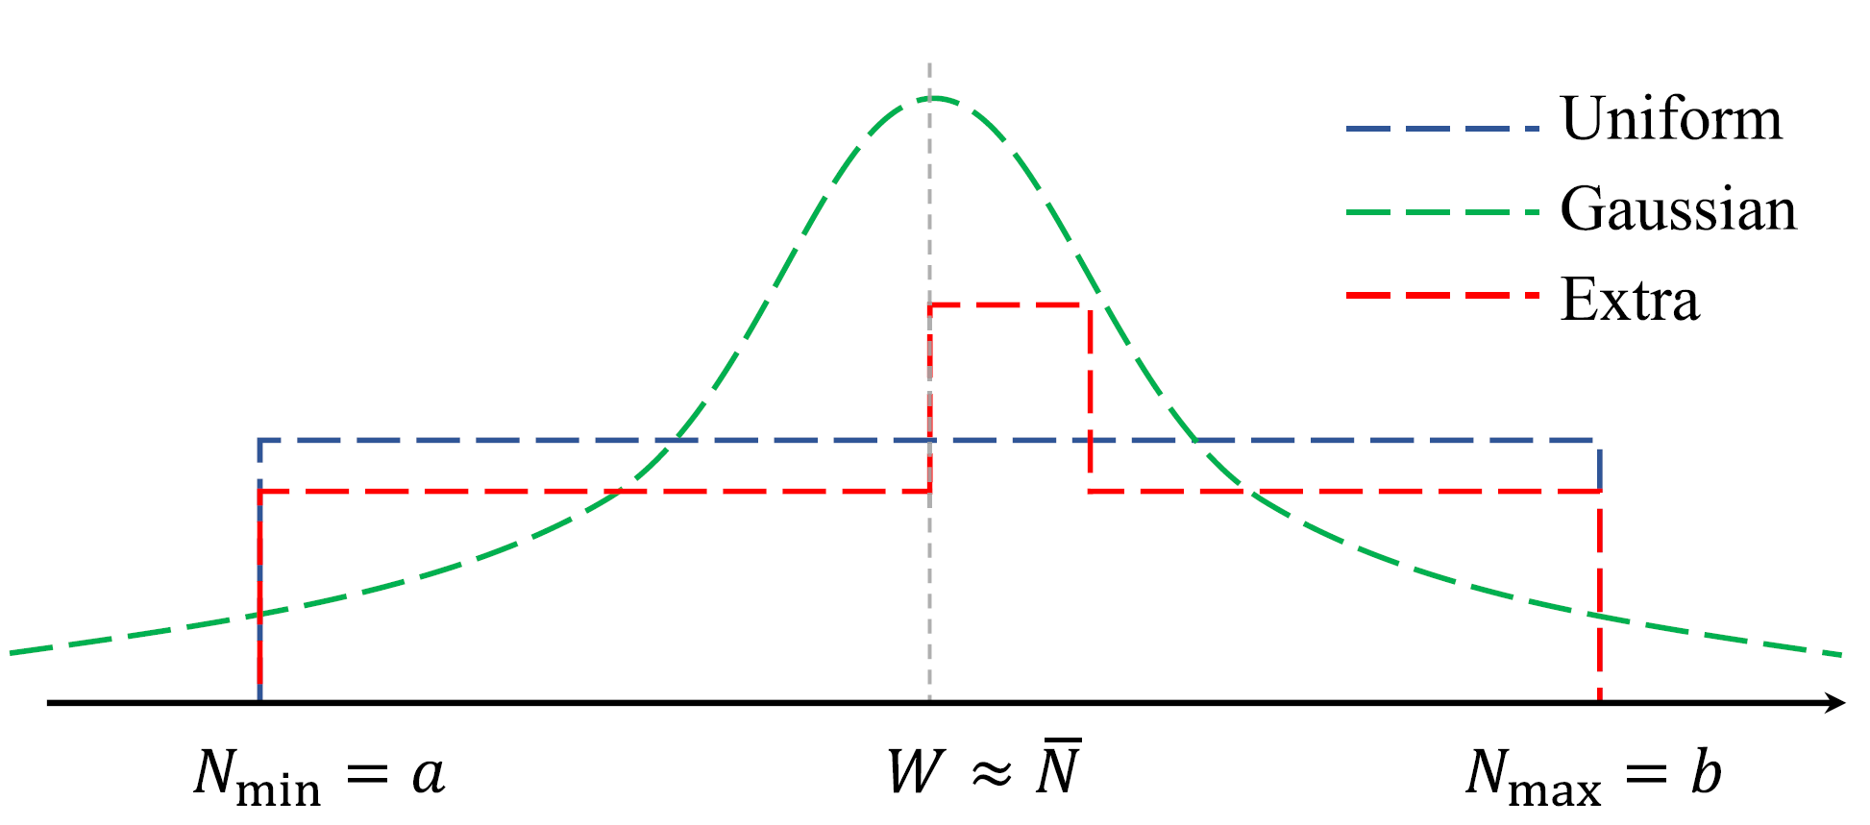
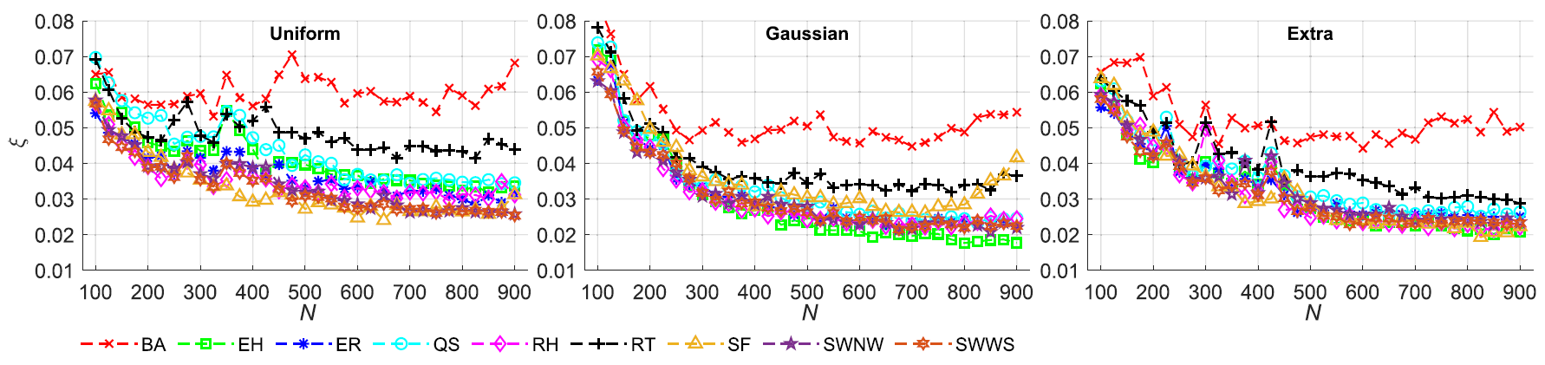
Using CNN for Robustness Evaluation (cont'd)
Y. Lou, C. Wu, J. Li, L. Wang, & G. Chen. Network Robustness Prediction: Influence of Training Data Distributions. IEEE Transactions on Neural Networks and Learning Systems, 35(10): 13496–13507 (2024)
Notes:
explore the training data distributions
how such distributions influence the results for different CNN models

Slide 29
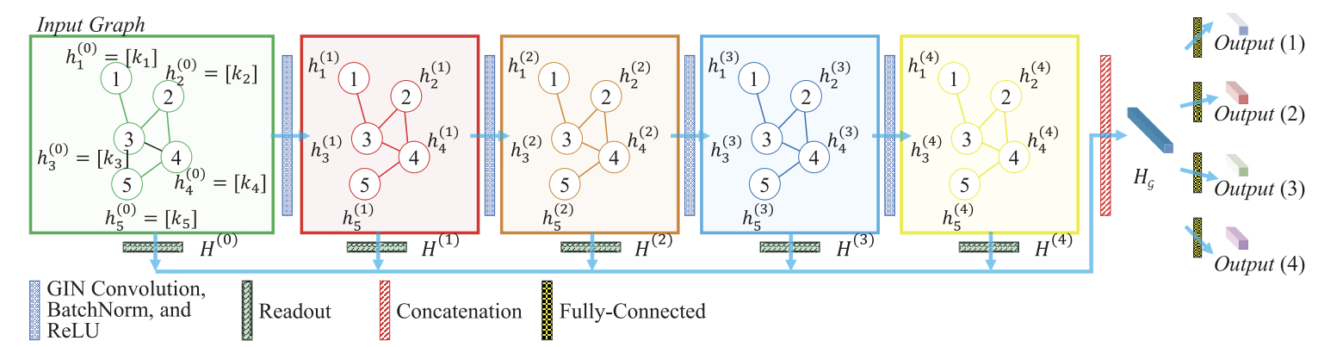
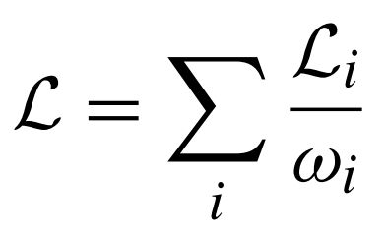
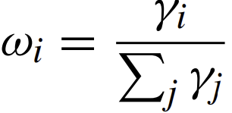
Using GNN for Robustness Evaluation
K. Xu, W. Hu, J. Leskovec, & S. Jegelka. How Powerful are Graph Neural Networks?” in Proc. ICLR, pp. 1–17 (2019)
A. Kendall, Y. Gal, & R. Cipolla. Multi-task Learning Using Uncertainty to Weigh Losses for Scene Geometry and Semantics,” in Proc. CVPR, pp. 7482–7491 (2018)
C. Wu, Y. Lou, J. Li, L. Wang, S. Xie, & G. Chen. A Multitask Network Robustness Analysis System Based on the Graph Isomorphism Network. IEEE Transactions on Cybernetics, 54(11): 6630–6642 (2024)
Notes:
GNN + multi-task manner
We tried a few models, such as GCN, GAT, and finally used GIN (graph isomorphism network), just because it performs well, and I like theoretical contribution in Ref. [12]
[Multi-task]
$γ_{i}$ is the variance of $ℒ_{i}$ within the current epoch of training

Slide 30
Contents
Preliminaries
Evaluation and Prediction
Optimization
Summary

Slide 31
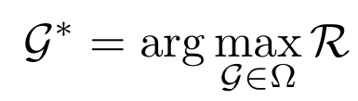
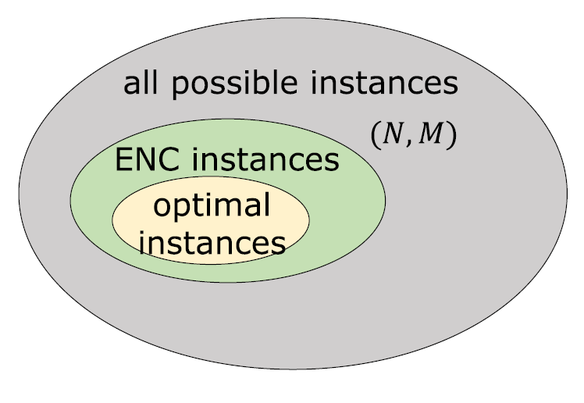
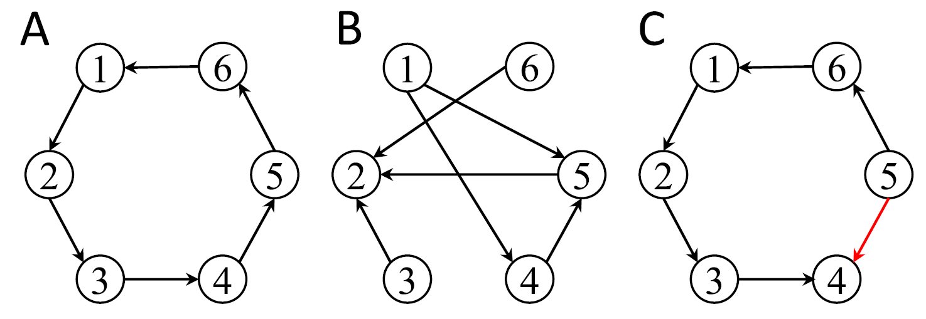
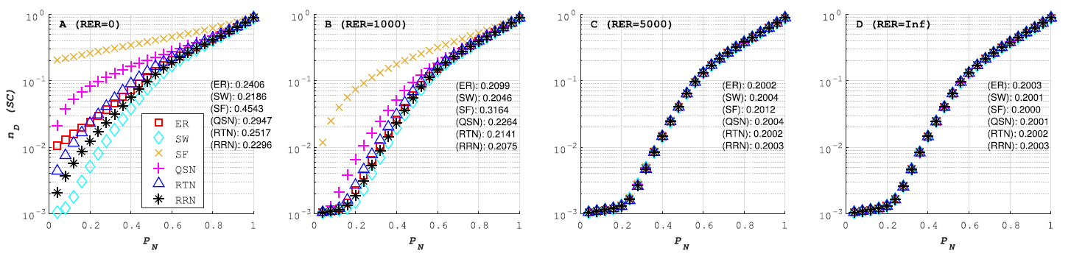
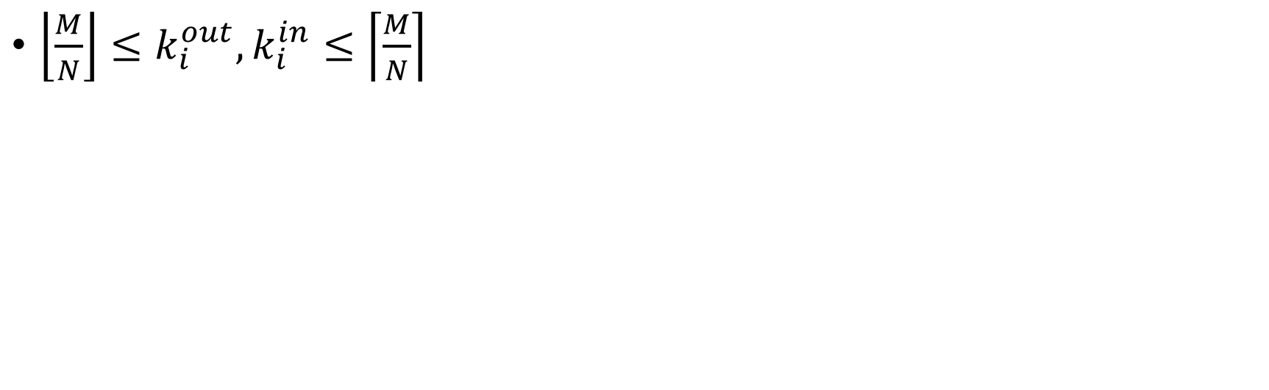
Optimization: Empirical Necessary Condition
$\left\lfloor \frac{M}{N}\right\rfloor ≤k_{i}^{out},k_{i}^{in}≤\left\lceil \frac{M}{N}\right\rceil$
Y. Lou, L. Wang, K.F. Tsang, & G. Chen. Towards Optimal Robustness of Network Controllability: An Empirical Necessary Condition. IEEE Transactions on Circuits and Systems I: Regular Papers, 67(9): 3163–3174 (2020)
Notes:
[Empirical Necessary Condition]
For controllability robustness only, not for connectivity robustness
Empirically observed from small-scaled networks :: an exhaustive search

Slide 32
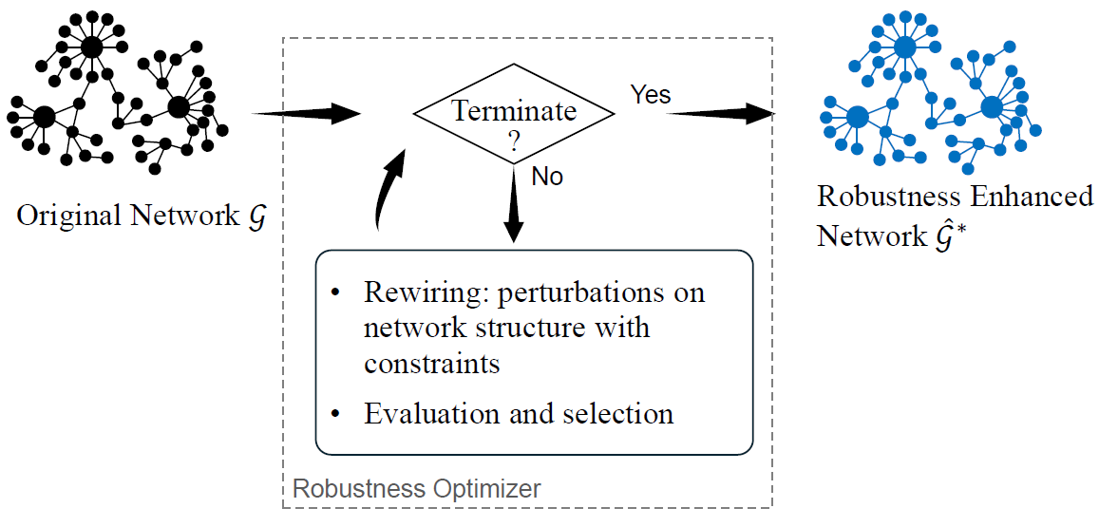
Optimization: Robustness Potential Explorer
Y. Lou, C. Wu, L. Chen, L. Zhou, L. Wang, & G. Chen. Exploring the Potential for Enhancing Structural Robustness of Complex Networks. IEEE Computational Intelligence Magazine (2025)
Notes:
Using evolutionary computation for structure modification towards optimal robustness

Slide 33
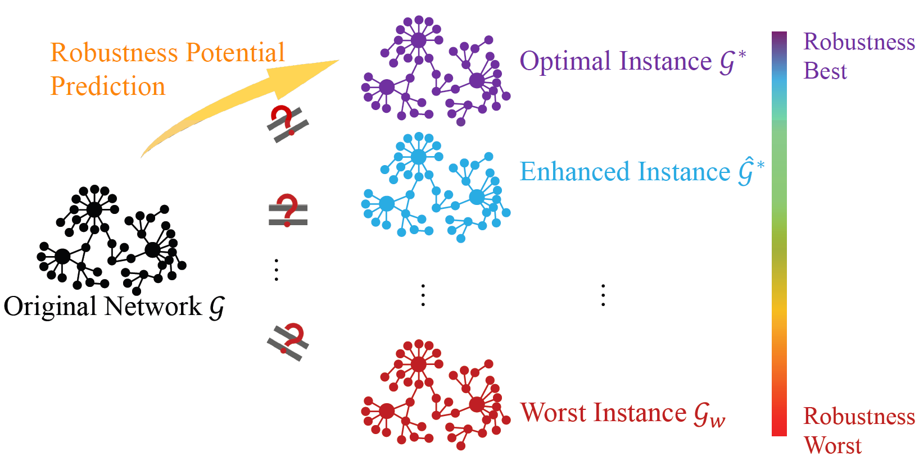
Optimization: Robustness Potential Explorer (cont'd)
Y. Lou, C. Wu, L. Chen, L. Zhou, L. Wang, & G. Chen. Exploring the Potential for Enhancing Structural Robustness of Complex Networks. IEEE Computational Intelligence Magazine (2025)
Notes:
By optimization and de-optimization, we can explore the spectrum of the best and worst robustness if a given network
We wish to explore the position of a given network instance within its spectrum
We also wish to predict the upper and lower bound of its robustness

Slide 34
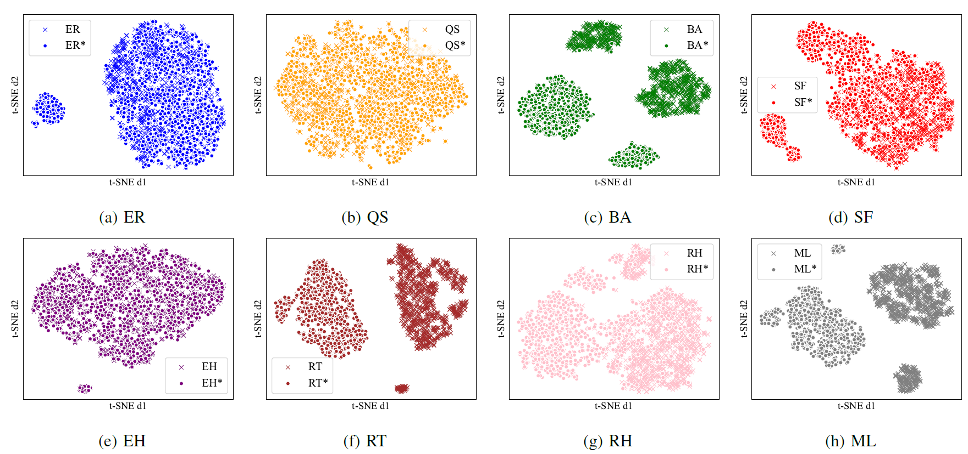
Optimization: Empirical Necessary Condition
Y. Lou, C. Wu, L. Chen, L. Zhou, L. Wang, & G. Chen. Exploring the Potential for Enhancing Structural Robustness of Complex Networks. IEEE Computational Intelligence Magazine (2025)
Notes:
Visualization: * means optimized, (empirically sufficiently optimized), but cannot guarantee
For different topologies, the visualization results are different
Distinguishable and Undistinguishable
We used a set of 20 commonly used features as the input

Slide 35
Contents
Preliminaries
Evaluation and Prediction
Optimization
Summary
Notes:
Rely on theoretical implications, assumptions, or well-supported practical observations
Low computational cost

Slide 36
Summary
Developed realistic metrics to assess the robustness of various key functionalities
Applied analytical methods and computational approaches (ML, CNN, GNN) for robustness evaluation
Designed optimal conditions and created a robustness potential explorer
Notes:
A brief summary of What we have done

Slide 37
Future Work
Metrics
Practical metrics: multi-objective, multi-dimensional, real-world problem based
Define destruction thresholds/levels
Evaluation
Faster and accurate destruction level detection
Machine learning and data-driven methods to improve evaluation efficiency
Identify hidden correlations
Optimization
Data-driven and analytical
To explore potential future applications in UAV and LEO networks
Notes:
A brief Introduction of What we are going to do

Slide 38
Acknowledgements
Prof. Guanrong Chen City University of Hong Kong
Prof. Lin Wang Shanghai Jiao Tong University
Prof. Xiang Li Tongji University
Dr. Yaodong He Tencent
Prof. Shengli Xie Guangdong University of Technology
Prof. Junli Li Sichuan Normal University
M.Sc. Students/Graduates:
Mr. Chengpei Wu Sichuan University
Mr. Liang Chen Sichuan Normal University
Ms. Wenli Huang Sichuan Normal University
Notes:
Special thanks to Prof. Chen

Slide 39


Thank You!
Felix Yang Lou
E-mail: felix.lou@ieee.org
Notes:
find me via email or WeChat

